Slide 1
Laserfiche 12 Updates
Presented by Laserfiche

Slide 2
Laserfiche 12 is the biggest release with the most innovations and new product features in recent Laserfiche history.”
Michael Allen
CTO, Laserfiche, Empower 2024 General Session

Slide 3
What is Laserfiche 12 about?
Laserfiche 12 is about delighting our customers and users.
Brand new features to streamline metadata management, testing, administration, and simplify deployments
Common operations made easier and more intuitive
Improved identity management and performance for growing systems
Consistent configuration and usability throughout all products
Training and education resources to set you up for success

Slide 4
System Admin Hub
Simplified Deployment
Identity Management
Forms
Test Mode
Metadata Designer
Modern Installers
Laserfiche 12
Notes:
Laserfiche 12 will be the biggest release of Laserfiche 8 with the most innovations and new product features since the release of Laserfiche 8 in 2008. A new administration console, updates to Forms, and a powerful new metadata view for repositories are just what’s in store for the initial release. Laserfiche 12 won’t stop there with at least two more minor releases over the next three years shipping even more enhancements.

Slide 5
Laserfiche 12 overview
Key features:
Significant metadata enhancements + Metadata Designer
Test mode for forms processes
Admin hub for viewing your Laserfiche system at a glance
Additionally:
Focus on usability with a UI refresh, including desktop applications
Updates to training materials, ready day 1 of launch
Timeline:
Initial release of 12 in November 2024
Major update in Q1 2025
All supported products should have a new version by end of 2026

Slide 6
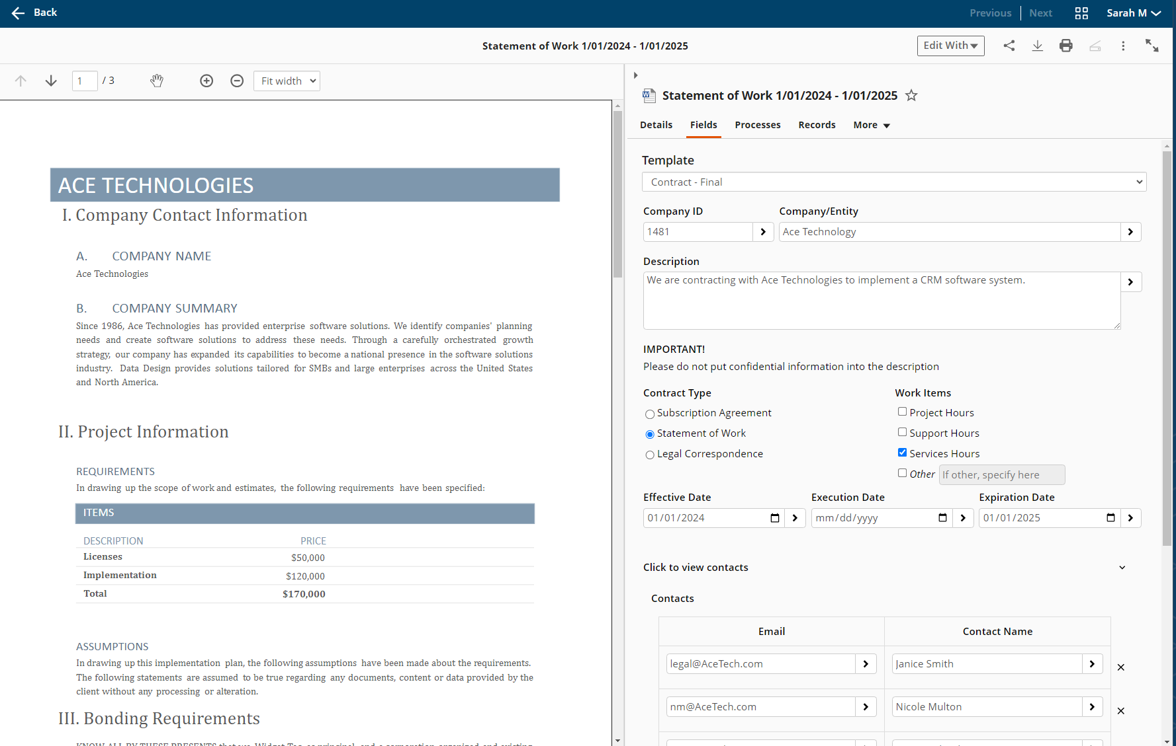
Laserfiche 12 Sneak Peek: Metadata Designer
Key Value:
With the new visual designer, there’s no need for developer-level skills to configure your document metadata.
Enter and display data in an intuitive way
Show/hide fields based on earlier input
Reduce mistakes and improve readability
Notes:
Key value of the Metadata Designer is it’s a very visual way to configure your metadata in a way that required some code before

Slide 7
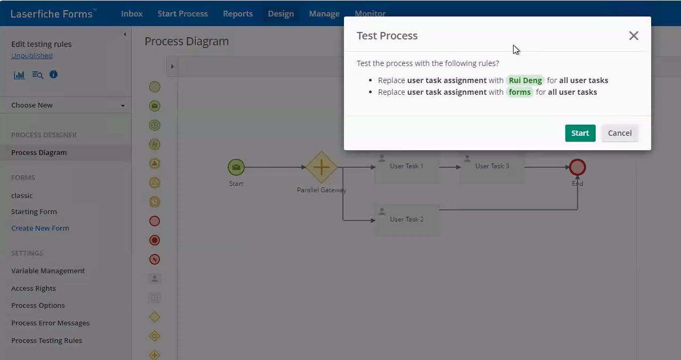
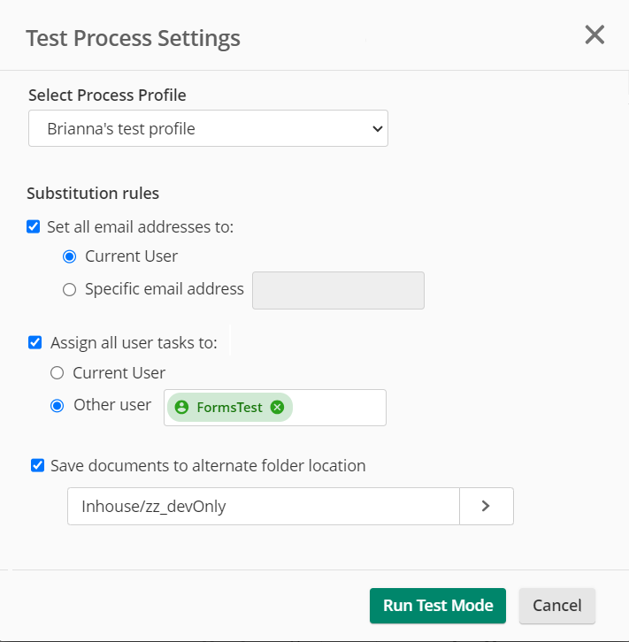
Laserfiche 12 Sneak Peek: Forms Test Mode
Key Value:
Don’t put your production data at risk or spend hours troubleshooting when testing your forms and workflows.
Easily modify, troubleshoot, and customize live forms with the new Forms test mode, without pressure of submitting test data into a live form
Test while keeping your critical processes running with no need for troubleshooting or downtime
New employees can train on internal forms without risk to production data
Notes:
We’re also releasoing a Forms Test Mode so you don’t put any production data at risk when troubleshooting your forms and workflows.

Slide 8
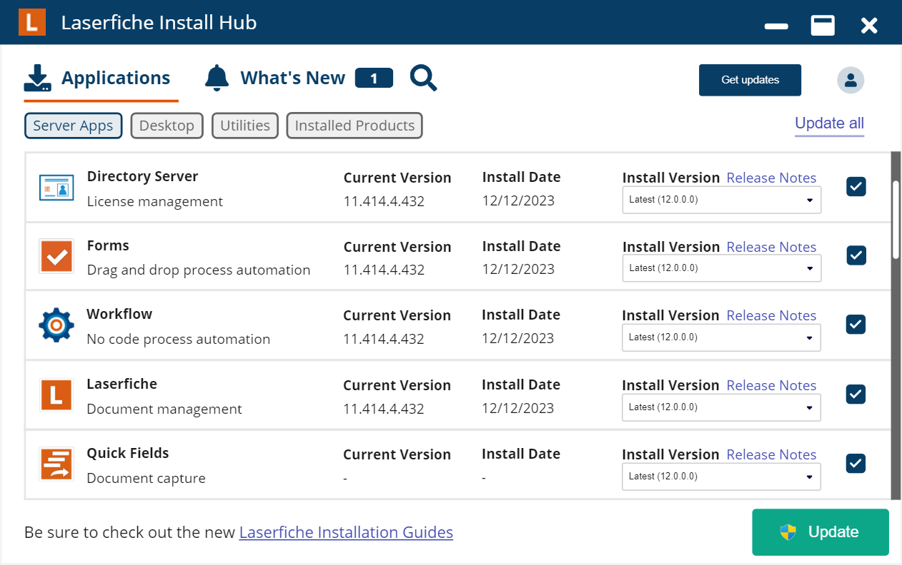
Upgrade & Admin Simplification
Key Value:
Reduce upgrade complexity and downtime during an upgrade, while getting additional tools and documents you need to shorten your upgrade lead time
Modern, automated installers captured in a centralized Installer Hub
Enterprise deployment education resources
Simplified SSO configuration and management
License renewal troubleshooting tools
Forms DMZ secure configuration tools
Deployment Simplification​
Notes:
We’re also making it easier to administer and upgrade your Laserfiche system, no matter what version you’re on.

Slide 9
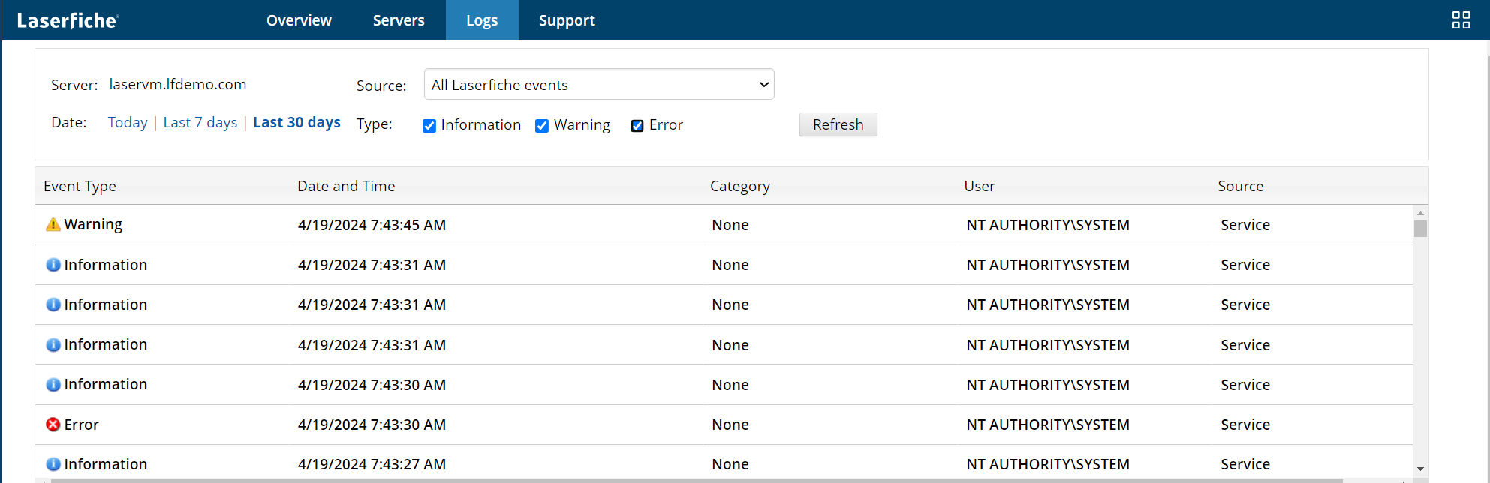
Admin Simplification & Identity Management
Key Value:
Seamlessly integrate with your enterprise identity provider and give Admins additional resources to manage accounts at scale
System-wide login page messages
SAML auto-login
Time-based account deprovisioning
SCIM group management
Additional SAML providers
Enhanced tools for migrating existing accounts to external directory providers

Slide 10
Additional Features
USABILITY
ADMINISTRATION
DEPLOYMENT SIMPLIFICATION
Easier Navigation: Integrated app-picker, compact views Simpler Search: ‘Find Document’ search mode Enhanced Mobile: Targeted progressive web apps
System Insights: Usage and activity forecasts Powerful Process Control: Availability and holiday scheduling Identity Management: LFDS user automation
Simpler Deployments: Install hub and deployment tools Laserfiche Connector: Centralized profiles Refreshed Tools: Quick Fields, Connector, DCC
Notes:
Overall Usability wil be improved, Administration will be easier, and Laserfiche is investing in additional tooling in making deployments and upgrades easier.

Slide 11
Laserfiche 12 Release Timeline
November 2024
- Metadata Designer
- Forms Test Mode
March 2025
Additional features, plus...
2H 2025
Additional features, plus...
2026
Additional features, plus...
- Web client (including Scanning and Office Plugin)
- Workflow
- Laserfiche Server & Directory Server (LfDS)
- Connector
- WebLink
- Mobile PWAs
- Snapshot
- Quick Fields Server + Scanning
- DocuSign Import Service
- Boomi Connector
- Desktop Admin
- Admin Hub
- Import Agent & Email archive
- Quick Fields + Quick Fields Agent
- Desktop Client
- Audit Trail
- API Server
- DCC
1
3
2
4
Bringing Laserfiche 12 features to Laserfiche Cloud:
Notes:
Laserfiche 12 is arriving November 2024, with additional updates scheduled for March 2025.

Slide 12
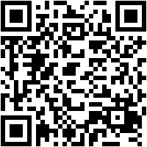
Upcoming Laserfiche Webinars
Live Preview of Laserfiche 12 – Self Hosted
July 23, 2024
11:00 a.m. – 12:00 p.m. PT
Laserfiche 12 brings a number of key enhancements directly from customer requests, and we're excited to share this preview with you.

Slide 13
Laserfiche 12
Deeper Dive

Slide 14
Metadata Enhancements

Slide 15
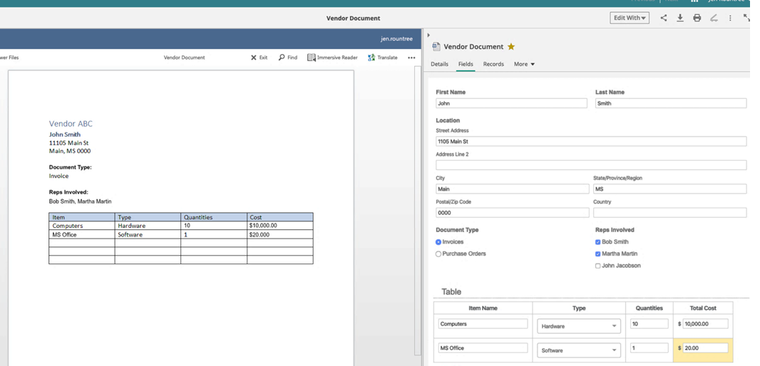
Laserfiche 12 Sneak Peek: Metadata Designer
Key Value:
With the new visual designer, there’s no need for developer-level skills to configure your document metadata.
Enter and display data in an intuitive way
Show/hide fields based on earlier input
Reduce mistakes and improve readability
Notes:
Key value of the Metadata Designer is it’s a very visual way to configure your metadata in a way that required some code before

Slide 16
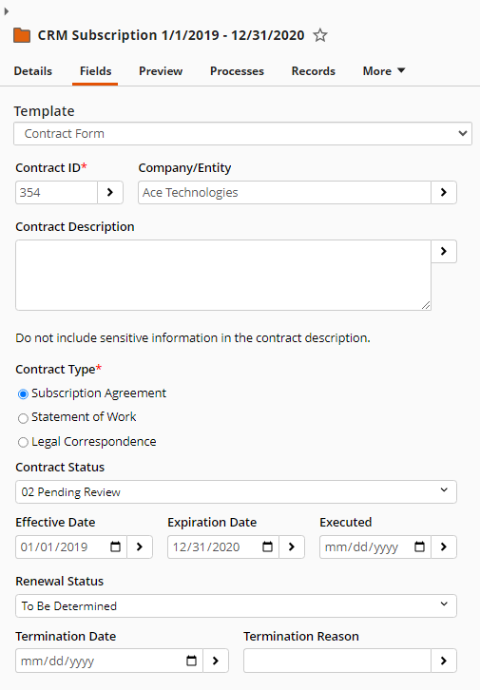
Transform your metadata
Notes:
Take multiple fields and compress them down into radio buttons vs drop downs for faster management

Slide 17
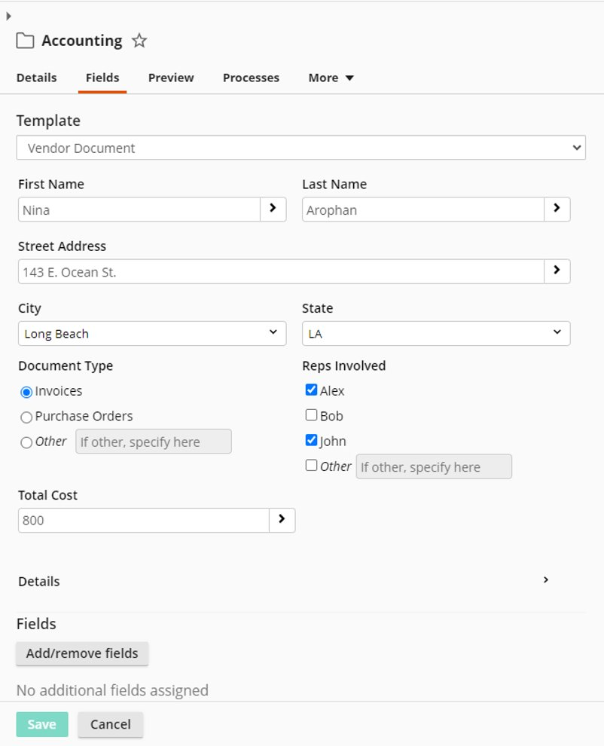
Intuitive templates with rich metadata
Data entry made easier
Bringing some of the power of Forms to the repository metadata
All existing fields supported
New powerful display options
Notes:
Display forms data more intuitively with checkboxes and radio buttons

Slide 18
Notes:
Metadata designer, easy to use
Familiar if you know Forms.
Speaking of Forms, let's switch gears, who's all built a form?
Who's accidently spammed their manager..?
Important of testing. As true as possible.
Video 5 3:22-3:35

Slide 19
Laserfiche 12 Metadata Enhancements
More intuitive data entry
Compatible with existing metadata
Table views for multi-value field groups
Better list handling
Checkboxes
Radio buttons
Customizable "Other" option
Only show fields when relevant
User-friendly field labels for display
Side-by-side fields with adjustable width
Collapsible sections
Instructional text
November release will include:
Easily transform existing templates
Compatibility view for older clients
Full support for existing fields

Slide 20
Forms Test Mode

Slide 21
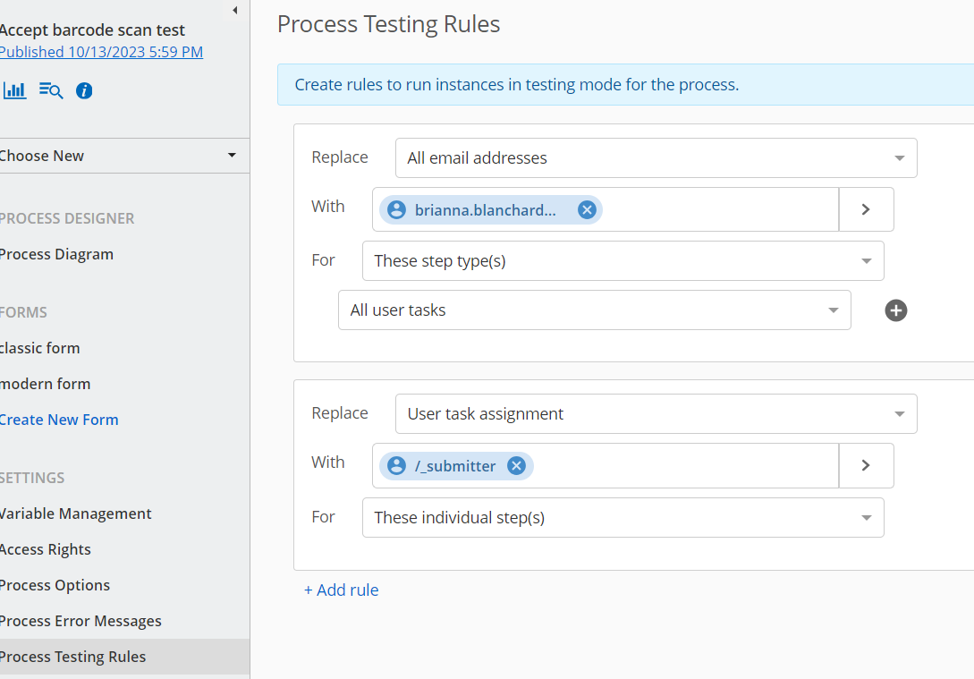
Laserfiche 12 Sneak Peek: Forms Test Mode
Key Value:
Don’t put your production data at risk or spend hours troubleshooting when testing your forms and workflows.
Easily modify, troubleshoot, and customize live forms with the new Forms test mode, without pressure of submitting test data into a live form
Test while keeping your critical processes running with no need for troubleshooting or downtime
New employees can train on internal forms without risk to production data
Notes:
We’re also releasing a Forms Test Mode so you don’t put any production data at risk when troubleshooting your forms and workflows.

Slide 22
Notes:
First, a quick way to switch
App picker
When I modify AP Process, keep it production ready
This is going to go to manager approval
Run as test mode
Video 6: 3:49-4:16

Slide 23
Notes:
Quick fill out process, we're testing it here.
Show email and task coming to us
Monitor as data, can filter, leave out of reports, etc.
Video 7 – 4:34-5:14

Slide 24
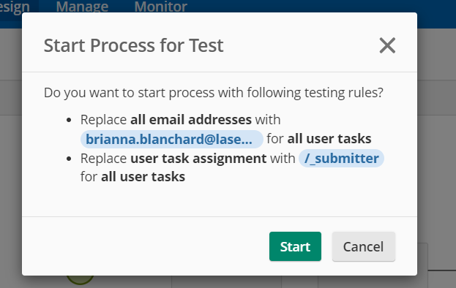
Forms Test Mode
No more temporary modification
Test actual process using automatic substitutions
Per task type and/or per specific step
Existing users, ad-hoc emails, and token support
See emails like recipients would!

Slide 25
Administration Hub

Slide 26
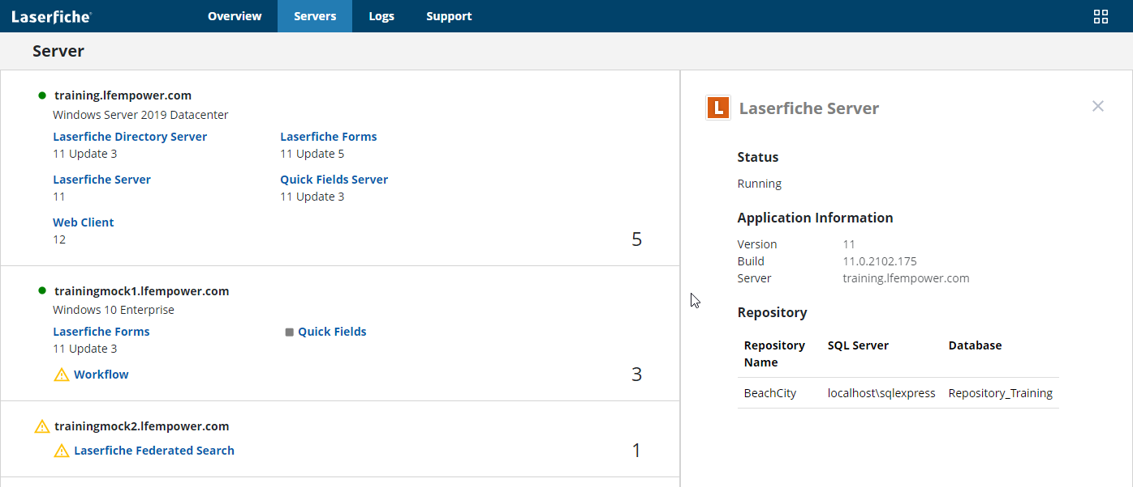
Laserfiche 12 Sneak Peek: Administration Hub
Key Value:
With the new Admin Hub, spend less time needing to collect or locate information to administer or support your Laserfiche system
Easily understand what is a part of your Laserfiche system and environments (servers, applications, versions, etc.)
System Metrics
Centralized logging
Support Information

Slide 27
Notes:
App picker to admin hub
Brand new, showing for first time here
System overview
Video 8 5:30-5:39 – System Overview

Slide 28
Notes:
Server information
Logs
Video 9 - Server

Slide 29
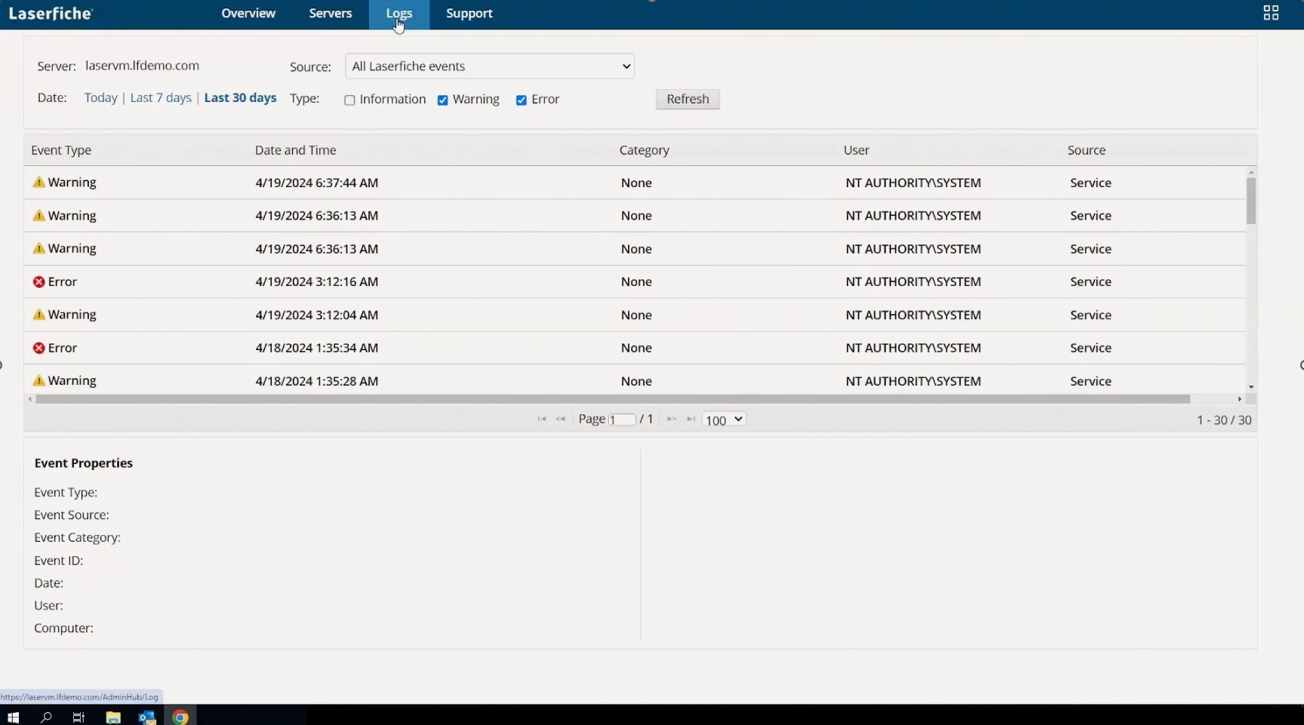
Laserfiche 12 Sneak Peek: Administration Hub
Key Value:
With the new Admin Hub, spend less time needing to collect or locate information to administer or support your Laserfiche system
Easily understand what is a part of your Laserfiche system and environments (servers, applications, versions, etc.)
System Metrics
Centralized logging
Support Information

Slide 30
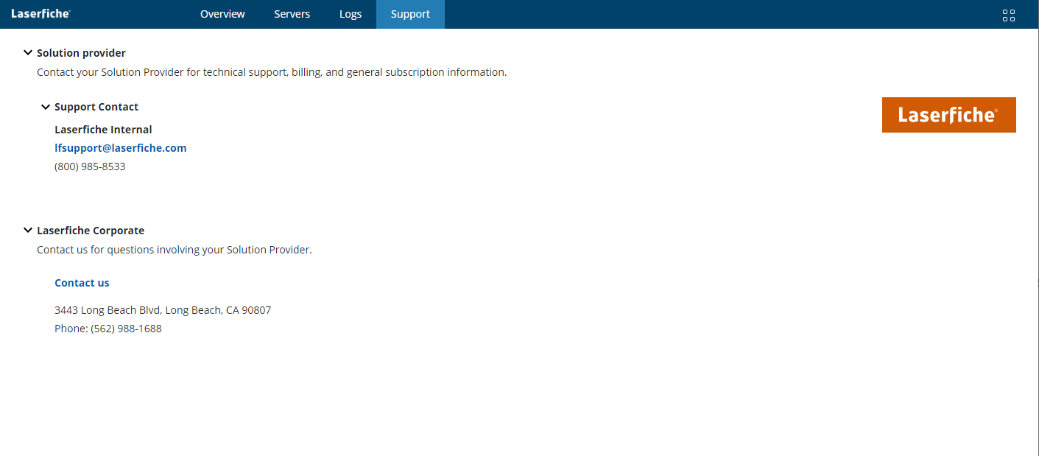
Laserfiche 12 Sneak Peek: Administration Hub
Key Value:
With the new Admin Hub, spend less time needing to collect or locate information to administer or support your Laserfiche system
Easily understand what is a part of your Laserfiche system and environments (servers, applications, versions, etc.)
System Metrics
Centralized logging
Support Information

Slide 31
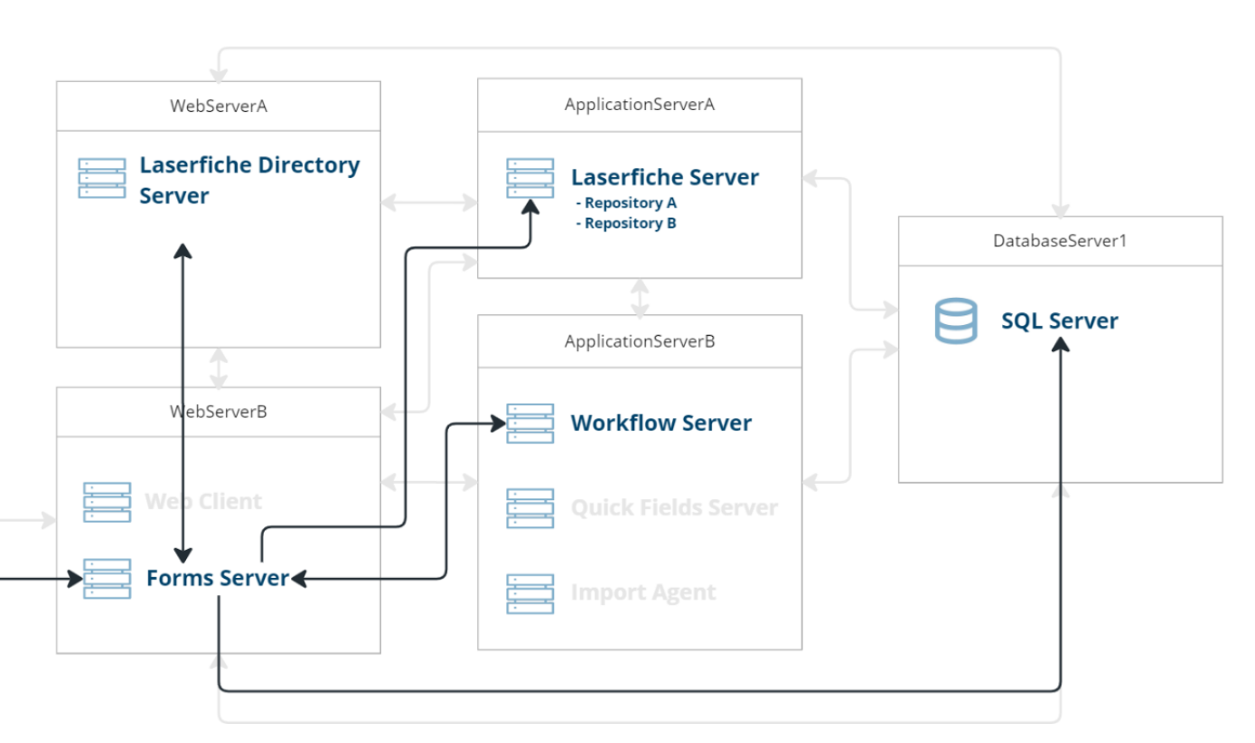
More centralization and functionality
IT Administrator
Laserfiche Administrator
Laserfiche Designer
System overview
Visualization and troubleshooting
License usage forecasting
Workflow stats
Stats for ROI calculation
Dive deep into application connections
Solution-focused view

Slide 32
Next: Laserfiche Usage Insights
Coming in 2025
License usage and forecasting
Workflow, Forms, and repository stats
System-wide workflow insights

Slide 33
In Summary: Administration in Laserfiche 12
View all Laserfiche servers and installed applications
Are there pending updates?
What applications are currently running?
What was installed?
Dynamically updated system diagram
Centralized log viewer for troubleshooting and providing for Support

Slide 34
LF 12 Recap
Quickly test process flows
Dynamically assigns user tasks and emails to specified test user/email
Keep test data out of production reporting and monitoring
More intuitive data entry
Table views for multi-value field groups
Better list handling
Checkboxes
Radio buttons
Customizable "Other" option
Only show fields when relevant (rules)
User-friendly field labels for display
Side-by-side fields with adjustable width
Collapsible sections
Instructional text
Visualize and access entire Laserfiche system
Generated System diagram
Navigate to any administration page
View logs in a central location

Slide 35
Additional Features

Slide 36
Additional Features
USABILITY
ADMINISTRATION
DEPLOYMENT SIMPLIFICATION
Easier Navigation: Integrated app-picker, compact views Simpler Search: ‘Find Document’ search mode Enhanced Mobile: Targeted progressive web apps
System Insights: Usage and activity forecasts Powerful Process Control: Availability and holiday scheduling Identity Management: LFDS user automation
Simpler Deployments: Install hub and deployment tools Laserfiche Connector: Centralized profiles Refreshed Tools: Quick Fields, Connector, DCC
Notes:
Overall Usability wil be improved, Administration will be easier, and Laserfiche is investing in additional tooling in making deployments and upgrades easier.

Slide 37
Usability enhancements – from all of you!
More built-in options for common searches
Quickly filter by document type within current folder
New UI for administrators to set and update group-based settings
More options for embedding documents
Quickly duplicate documents
Editable file path
Drag-and-drop folder support
Download multiple individual files
Better viewing of text-only documents without downloading

Slide 38
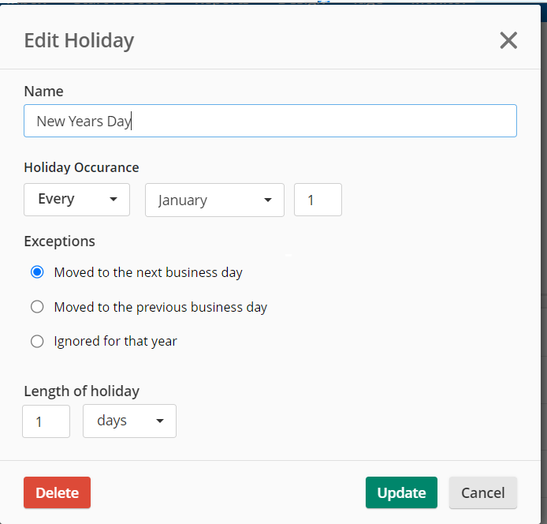
Holiday Calendar
Specify non-business days
Option to observe before/after
Centrally defined for ease of maintenance

Slide 39
Deployment Simplification
Find and download updates easily
Get notifications about pending updates
See system at a glace

Slide 40
Laserfiche 12 Release Timeline
November 2024
- Metadata Designer
- Forms Test Mode
March 2025
Additional features, plus...
2H 2025
Additional features, plus...
2026
Additional features, plus...
- Web client (including Scanning and Office Plugin)
- Workflow
- Laserfiche Server & Directory Server (LfDS)
- Quick Fields Server + Scanning
- DocuSign Import Service
- Boomi Connector
- Desktop Admin
- Admin Hub
- Import Agent & Email archive
- Desktop Client
- Audit Trail
- API Server
- DCC
- Quick Fields + Quick Fields Agent
- Connector
- WebLink
- Mobile PWAs
- Snapshot
1
3
2
4
Bringing Laserfiche 12 features to Laserfiche Cloud:
Notes:
Laserfiche 12 is arriving November 2024, with additional updates scheduled for March 2025.

Slide 41
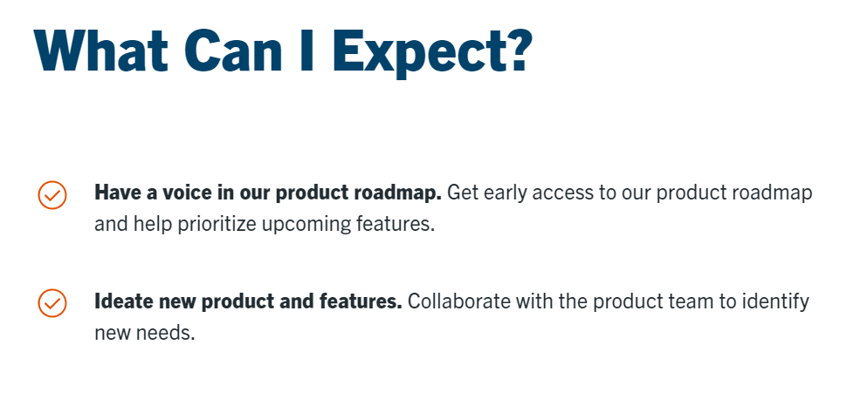
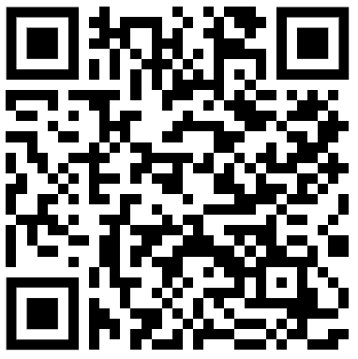
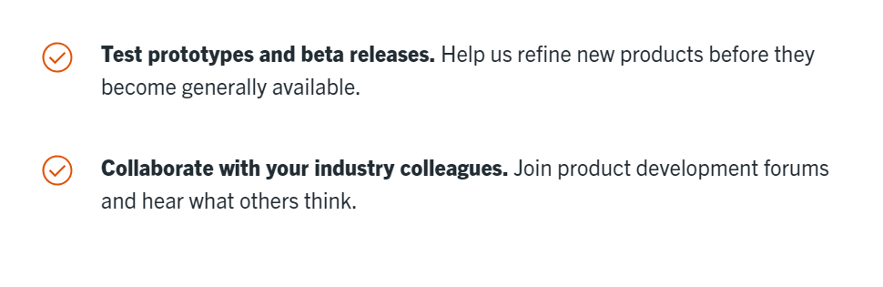
Customer Panel
July Customer Panel will be focused on LF 12 Feedback
Customer Panel Sign-up

Slide 42
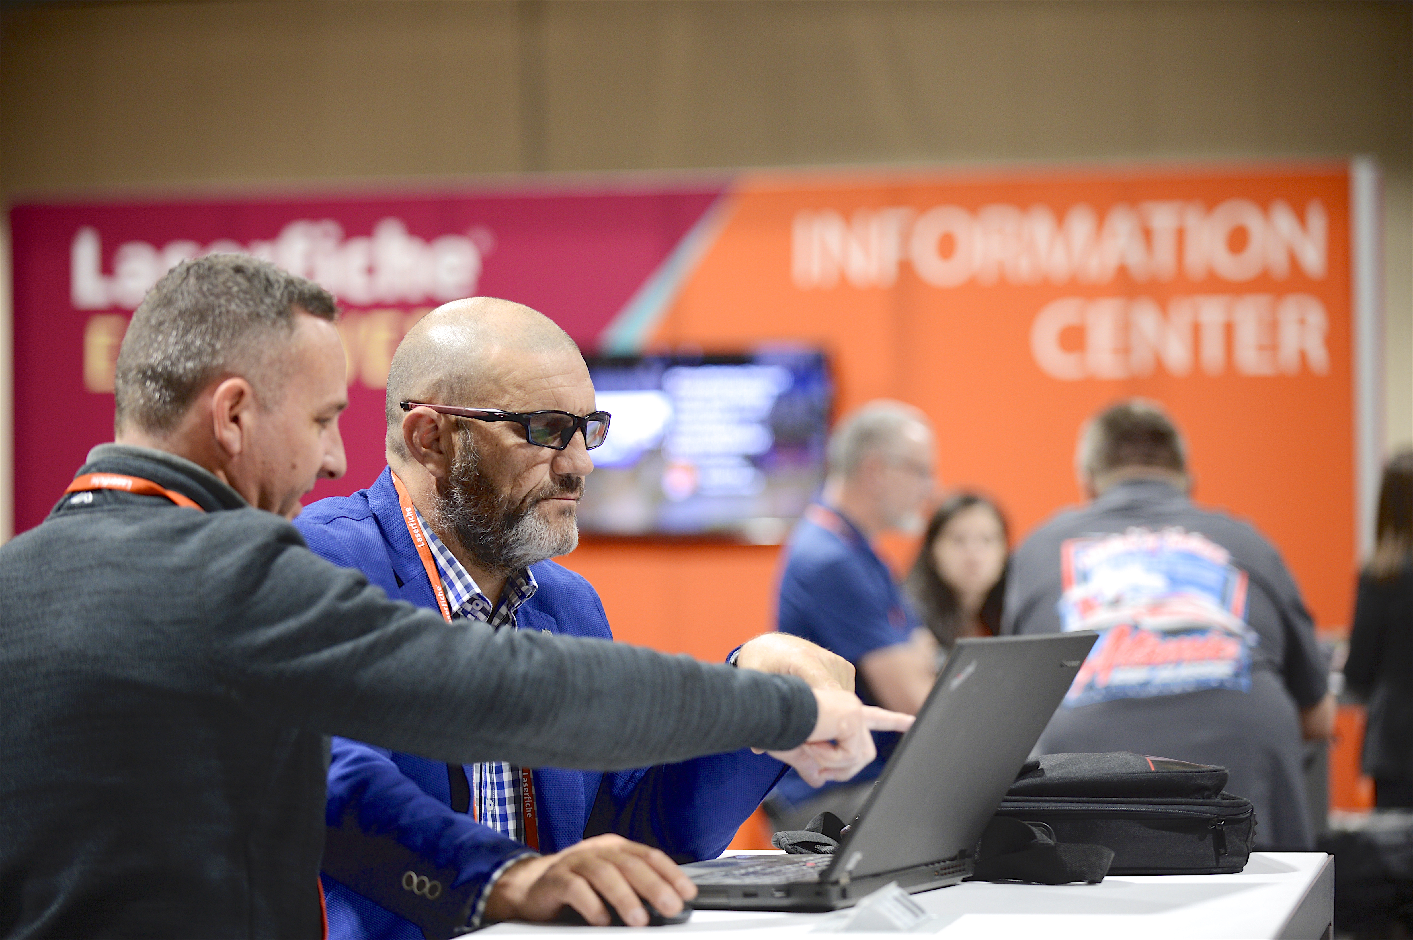
Laserfiche 12 Educational Resources
Updated eLearning on Day 1
Product sandbox to try out Laserfiche 12 NEW!
All Aspire training content is part of customer subscriptions
Notes:
We are excited to announce educational resources for Laserfiche 12 coming with the release of Laserfiche 12 later this year!
In addition to eLearning courses and guides, we are excited to include a Laserfiche 12 product sandbox as part of the Laserfiche 12 certification, to help you practice your skills before taking the certification assessment. Visit the Laserfiche 12 booth at the Info Center to experience this product sandbox for yourself.

Slide 43
Laserfiche 12 recap
Highlighted features:
Significant metadata enhancements
Test mode for forms processes
Admin hub for seeing Laserfiche system at a glance
Focus on usability with a UI refresh, including desktop applications
Updates to training materials
Timeline:
Initial release of 12 in November 2024
Major update in Q1 2025
All supported products should have a new version by end of 2026

Slide 44
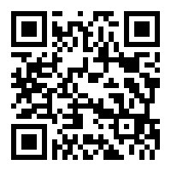
Thank you for attending!
Learn More About Laserfiche 12:
Laserfiche.com/products/lf12

